Slide 1


Stephane Lapointe, Orckestra - stephane@stephanelapointe.net / @s_lapointe
Guy Barrette, freelance Architect/Developer - guy@guybarrette.com / @GuyBarrette
Francois Boucher, Lixar IT - fboucher@frankysnotes.com / @fboucheros
Alexandre Brisebois, Microsoft – alexandre.brisebois@microsoft.com / @brisebois

Slide 2
Schedule
9:00:00 AM 9:05:00 AM Intro MSDEVMTL
9:05:00 AM 9:35:00 AM Intro sponsors
9:35:00 AM 10:50:00 AM Intro to services and Service Fabric Overview
10:50:00 AM 11:20:00 AM Labs 1 & 2
11:20:00 AM 11:50:00 AM Application Packaging & deployment
11:50:00 AM 12:20:00 PM Diner
12:20:00 PM 12:55:00 PM Labs 3 & 4
12:55:00 PM 1:30:00 PM MS at scale & High Availability
1:30:00 PM 1:40:00 PM Lab 5
1:40:00 PM 2:10:00 PM Diagnostics & Health policies
2:10:00 PM 2:20:00 PM Lab 6
2:20:00 PM 2:45:00 PM Who is using SF, Testing
2:45:00 PM 3:20:00 PM Lab 7 & 8
3:20:00 PM 3:40:00 PM Upgrades
3:40:00 PM 4:10:00 PM Lab 9
4:10:00 PM 4:15:00 PM Conclusion

Slide 3
Today we’re going to learn about how
Microservices enable development and management flexibility
Service Fabric is the platform for building applications with a microservices design approach
Service Fabric is battle tested and provides a rich platform for both development and management of services at scale

Slide 4
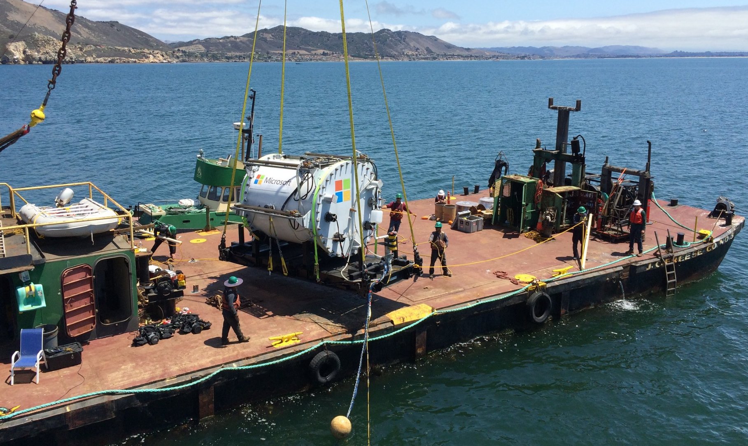

Slide 5
Azure Momentum
100,000
New Azure customer subscriptions/month
20 Million
SQL database hours used every day
>50 Trillion
Storage objects in Azure
“Microsoft is growing its cloud revenue faster than Amazon” – Business Insider 2016
AWS revenue grew about 69% but Microsoft Azure revenue grew by 127%
425 Million
Azure Active Directory Users
60 Billion
Hits to Websites run on Azure Web App Service
57%
Of Fortune 500 Companies use Microsoft Azure
>5 Trillion
Storage transactions every month
1 Trillion
Messages delivered every month with Event Hubs
1.4 Million
SQL Databases Deployed
In Azure

Slide 6
What do these have in common?
Skype for Business
Hybrid Ops
Azure Document DB
billions transactions/week
Intune
over 1m devices
Azure Core Infrastructure
thousands of machines
Event Hubs
20bn events/day
Bing Cortana
500m evals/sec
Azure SQL Database
millions of databases
Power BI

Slide 7
Microservices

Slide 8


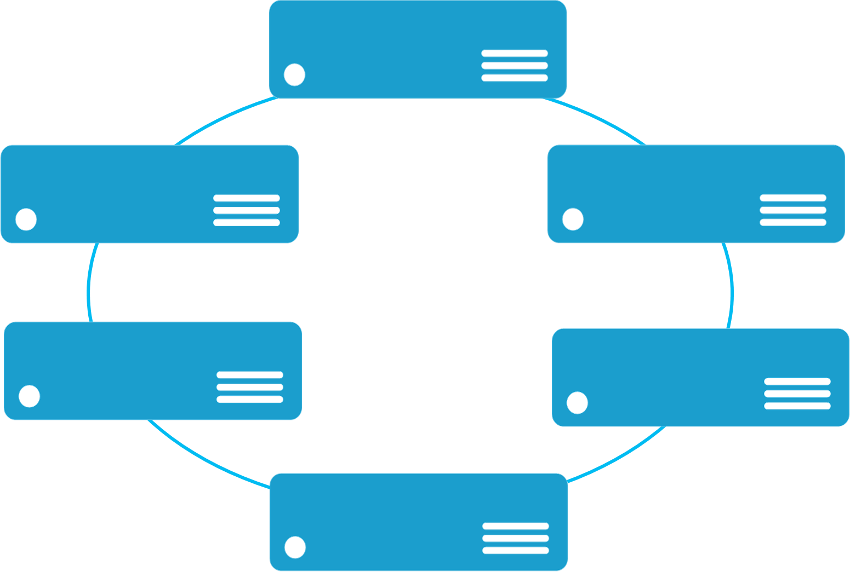


Monolithic application approach
Microservices application approach
A monolith app contains domain specific functionality and is normally divided by functional layers such as web, business and data
App 1
App 1
App 2
A microservice application separates functionality into separate smaller services.
Scales by cloning the app on multiple servers/VMs/Containers
Scales out by deploying each service independently creating instances of these services across servers/VMs/containers

Slide 9
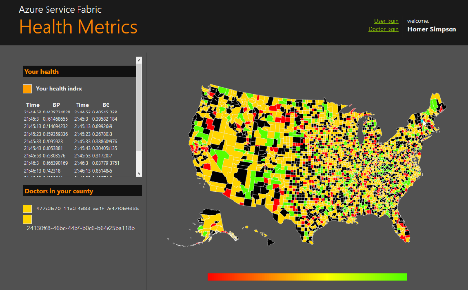

State in Monolithic approach
State in Microservices approach
Single monolithic database
Tiers of specific technologies
Graph of interconnected microservices
State typically scoped to the microservice
Variety of technologies used
Remote Storage for cold data
stateless presentation services
stateless services
stateful services
stateless services with
separate stores

Slide 10
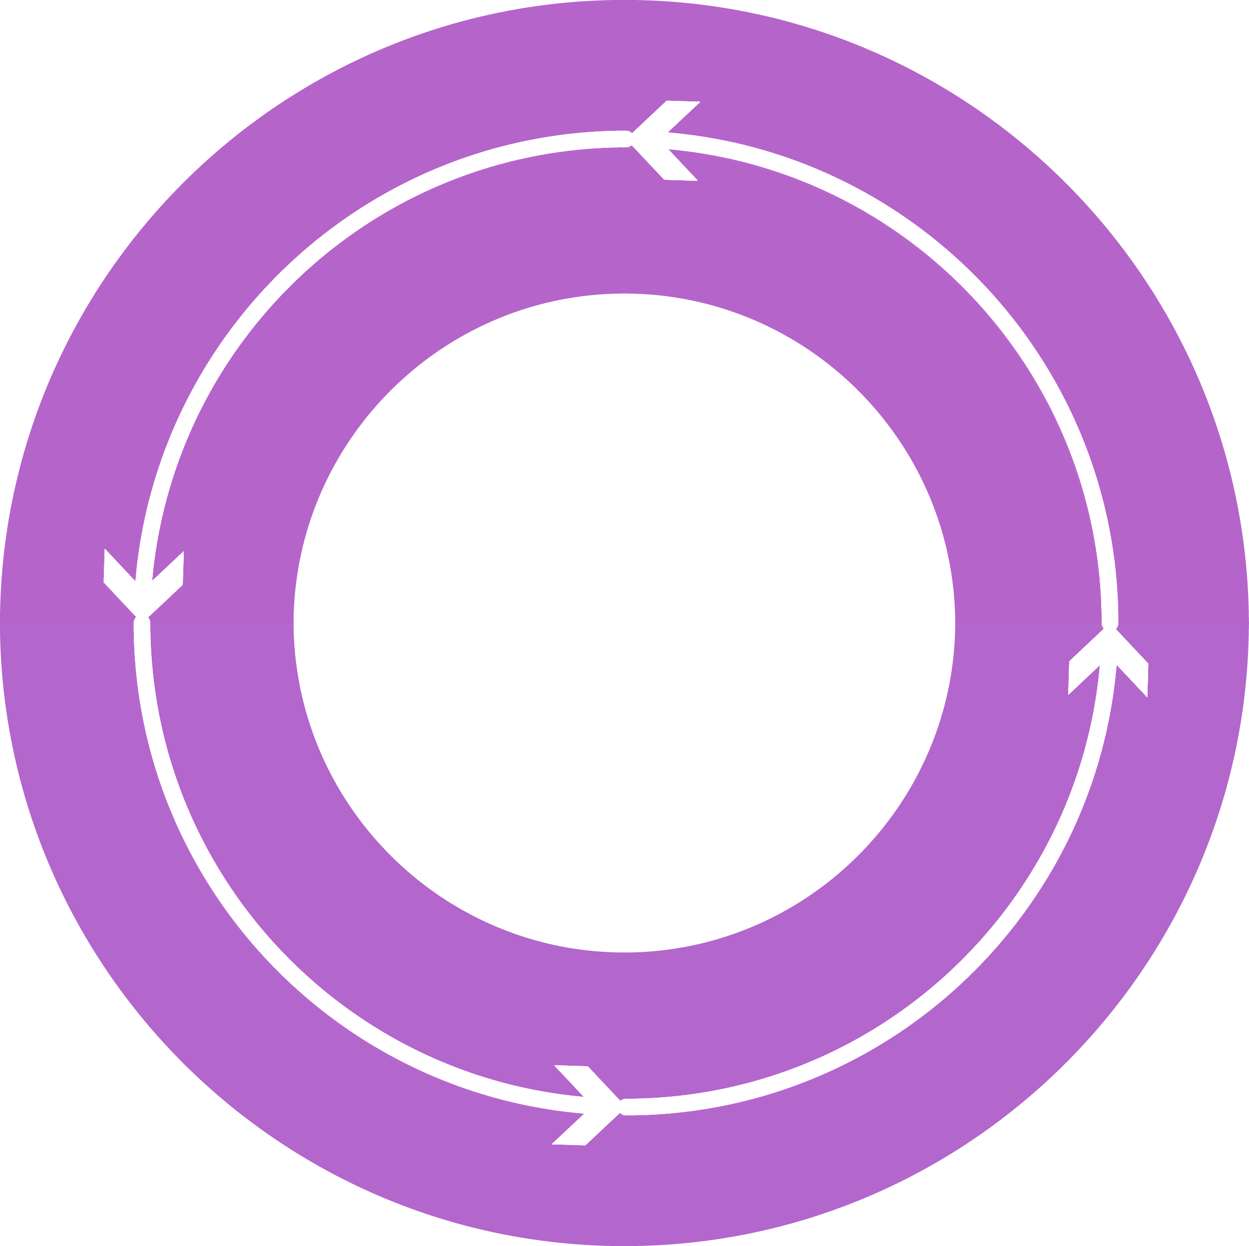


Why a Microservices approach?
Continually evolving applications
Faster delivery of features and capabilities to respond to customer expectations
Build and operate a service at scale
1
4
Monitor + Learn
Plan
Development
Production
2
3
Release
Develop + Test

Slide 11
OK… but why a Microservice approach?
Fault Isolation
Small Focused Teams
Build, scale, and upgrade independently
Compute resource utilization
Design/ Develop
Operate
Upgrade
Hard problems:
Service Availability
Resource Allocation
State Management
Versioning
Upgrades, roll backs, side by side deployment

Slide 12
A Microservice Platform
Build Applications with many Programming Frameworks and Languages
Microservices Platform
Deploy and Manage Applications to many Environments

Slide 13
A Microservice Platform
LifecycleMgmt
Independent Scaling
Independent Updates
Always On Availability
Resource Efficient
Stateless/
Stateful
Public Cloud
On Premises
Private cloud
Other Clouds

Slide 14
Setting-up a Cluster in Azure
What Is
Azure Service Fabric?

Slide 15
Service Fabric is
Next generation of PaaS on Azure
Elastic scale, OS updates, SF updates
Microservices platform for Windows and Linux
DevOps, rolling upgrades, etc.
Polycloud including on-premises
Programming models
Stateless Win32 apps written in any language (some feature not supported)
Reliable Services: Stateless & stateful (for hot data; gives low-latency reads)
OWIN/ASP.NET Core*
Service Fabric is free of charge
SDK: http://aka.ms/ServiceFabricSDK

Slide 16
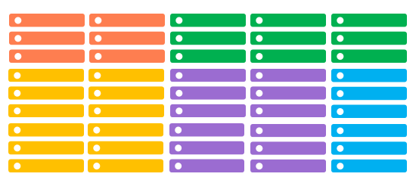
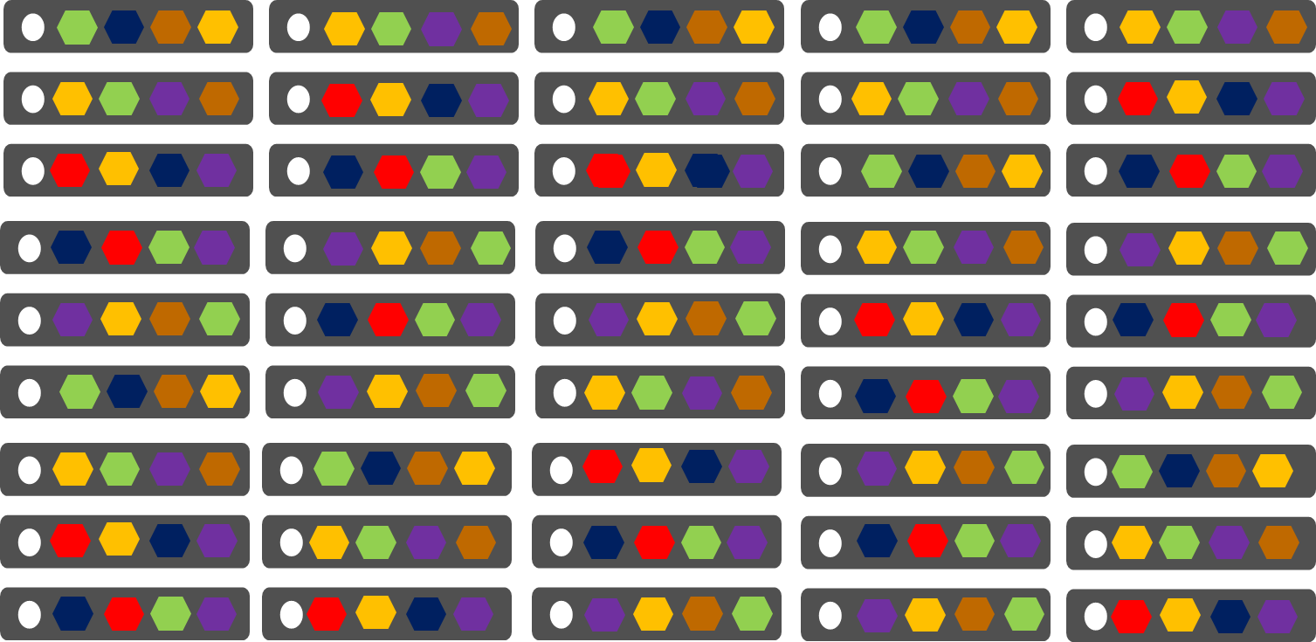
Cloud Services vs Service Fabric
Azure Cloud Services (Web & Worker Roles)
Azure Service Fabric
(Services)
1 role instance per VM
Uneven utilization
Low density
Slow deployment & upgrade (bound to VM)
Slow scaling and failure recovery
Limited fault tolerance
Many microservices per VM
Even Utilization (by default, customizable)
High density (customizable)
Fast deployment & upgrade
Fast scaling of independent microservices
Tunable fast fault tolerance

Slide 17
Microsoft Azure Service Fabric A platform for reliable, hyperscale, microservice-based applications
microservices
High Availability
Data Partitioning
Service Fabric
Health Monitoring
Container Orchestration & lifecycle management
Hybrid Operations
Self-healing
Simple programming models
High Density
Rolling Upgrades
Low Latency
Placement Constraints
Replication & Failover
Stateful services
Fast startup & shutdown
Load balancing
Hyper-Scale
Automated Rollback
Windows
Server
Linux
Windows
Server
Linux
Azure
Hosted Clouds
Windows
Server
Linux
Private Clouds

Slide 18
Service Fabric Subsystems
microservices
Application Programming Models
Management
Subsystem Deployment, Upgrade and Monitoring
Communication
Subsystem Service discovery
Reliability
Subsystem Reliability, Availability, Replication, Service Orchestration
Hosting & Activation
Subsystem Application lifecycle
Testability
Subsystem Fault Inject, Test in production
Federation Federates a set of nodes to form a consistent scalable fabric
Transport Secure point-to-point communication

Slide 19
Cluster
Set of OS instances (real or virtual) stitched together to form a pool of resources
Cluster can scale to 1000s of machines, is self repairing, and scales-up or down
Acts as environment-independent abstraction layer
Windows OS
Windows OS
Windows OS
Fabric
Node
Fabric
Node
Fabric
Node
Windows OS
Windows OS
Windows OS
Fabric
Node
Fabric
Node
Fabric
Node

Slide 20

Service Fabric Cluster
Datacenter (Azure, On Premises, Other Clouds )
PC/VM #2
Service Fabric
Your code, etc.
PC/VM #3
Management to deploy your code, etc. (Port: 19080)
Service Fabric
PC/VM #1
Your code, etc.
Service Fabric
PC/VM #4
Load Balancer
Your code, etc.
Service Fabric
Your code, etc.
PC/VM #5
App Web Request (Port: 80/443/?)
Service Fabric
Your code, etc.

Slide 21
Service Fabric’s Infrastructure Services
Cluster Manager (ports 19080 [REST] & 19000 [TCP]) Performs cluster REST & PowerShell/FabricClient operations
Failover Manager Rebalances resources as nodes come/go
Naming Maps service instances to endpoints
Image store (not on OneBox) Contains your Application packages
Upgrade Service (Azure only) Coordinates upgrading SF itself with Azure’s SFRP
C
Node #2
F
C
N
I
Node #1
N
C
I
F
Node #3
C
F
U
I
Node #5
N
F
U
Node #4
U
N
I
U

Slide 22
Setting-up a Cluster in Azure
Microservices with
Azure Service Fabric

Slide 23
Service Fabric Microservices
App1
App2
App Type Packages
Service Fabric Cluster VMs

Slide 24
Service Fabric Programming Models
Guest Executables
Bring any exe
Any language
Any programming model
Packaged as Application
Gets versioning, upgrade, monitoring, health, etc.
Reliable Services
Stateless & stateful services
Concurrent, granular state changes
Use of the Reliable Collections
Transactions across collections
Full platform integration
Reliable Actors
Stateless & stateful actor objects
Simplified programming model
Single Threaded model
Great for scaled out compute and state

Slide 25
Programming models: Reliable Services
Reliable collections make it easy to build stateful services
An evolution of .NET collections - for the cloud
ReliableDictionary<T1,T2> and ReliableQueue<T>
Collections
Single machine
Single-threaded
Concurrent Collections
Single machine
Multi-threaded
Reliable Collections
Multi-machine
Replicated (HA)
Persistence (durable)
Asynchronous
Transactional

Slide 26
Reliable Services
.NET Programming model benefits
Networking Naming Service support
Self-reporting of instance’s load metrics
Integrate with code, config, & data upgrades
Efficiency (better density): Multiple services (types & instances) in a single process
Other programming models can be built on Service Fabric
Example: Reliable Actors

Slide 27
Transactionally Modifying Reliable Data
protected override async Task RunAsync(CancellationToken cancellationToke)
{
var requestQueue = await this.StateManager.GetOrAddAsync<IReliableQueue<CustomerRecord>>(“requests");
var locationDictionary = await this.StateManager.GetOrAddAsync<IReliableDictionary<Guid, LocationInfo>>(“locs");
var personDictionary = await this.StateManager.GetOrAddAsync<IReliableDictionary<Guid, Person>>(“ppl");
var customerListDictionary = await this.StateManager.GetOrAddAsync<IReliableDictionary<Guid, object>>(“customers");
while (true)
{
cancellationToke.ThrowIfCancellationRequested();
Guid customerId = Guid.NewGuid();
using (var tx = this.StateManager.CreateTransaction())
{
var customerRequestResult = await requestQueue.TryDequeueAsync(tx);
await customerListDictionary.AddAsync(tx, customerId, new object());
await personDictionary.AddAsync(tx, customerId, customerRequestResult.Value.person);
await locationDictionary.AddAsync(tx, customerId, customerRequestResult.Value.locInfo);
await tx.CommitAsync();
}
}
}
Everything happens or nothing happens!

Slide 28
Programming models: Reliable Actors
Independent units of compute and state
Large number of them executing in parallel
Communicates using asynchronous messaging
Single threaded execution
Automatically created and dehydrated as necessary

Slide 29
Comparing Reliable Actors & Reliable Service
Reliable Actors APIs | Reliable Services APIs
Your problem space involves many small independent units of state and logic | You need to maintain logic across multiple components
You want to work with single-threaded objects while still being able to scale and maintain consistency | You want to use reliable collections (like .NET Dictionary and Queue) to store and manage your state
You want the framework to manage the concurrency and granularity of state | You want to control the granularity and concurrency of your state
You want the platform to manage communication for you | You want to manage the communication and control the partitioning scheme for your service

Slide 30
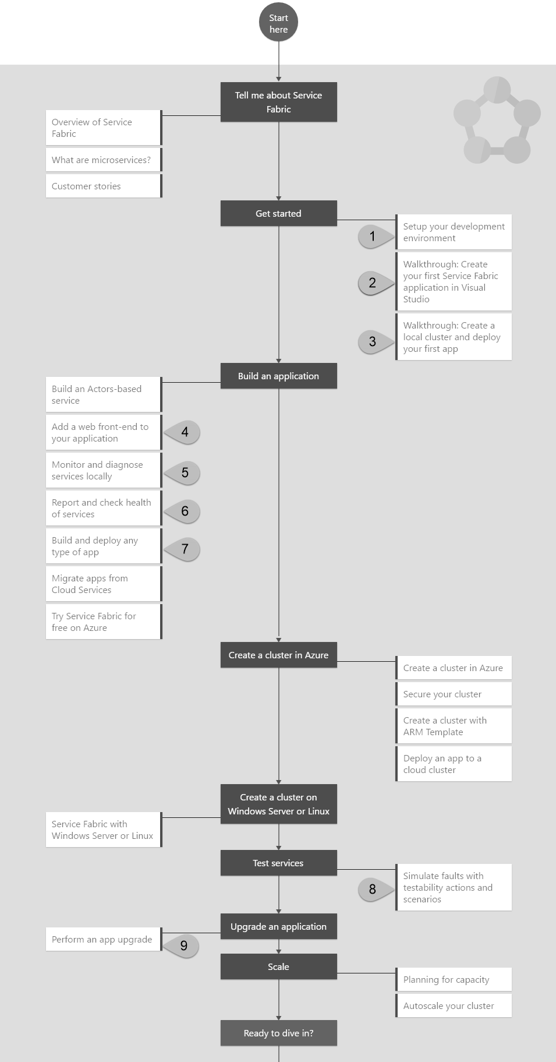
LAB ONE Setup your development environment http://bit.ly/sf-setup
LAB TWO Walkthrough: Create your first
Service Fabric application in Visual Studio http://bit.ly/sf-lab-2

Slide 31
Setting-up a Cluster in Azure
Application Packaging & Deployment

Slide 32
Service type
Services types are composed of code/config/data packages
Code packages define an entry point (dll or exe)
Config packages define service specific config information
Data packages define static resources (eg. images)
Packages can be independently versioned
<ServiceManifest Name="QueueService" Version="1.0">
<ServiceTypes>
<StatefulServiceType ServiceTypeName="QueueServiceType" HasPersistedState="true" />
</ServiceTypes>
<CodePackage Name="Code" Version="1.0">
<EntryPoint>
<ExeHost>
<Program>ServiceHost.exe</Program>
</ExeHost>
</EntryPoint>
</CodePackage>
<ConfigPackage Name="Config" Version="1.0" />
<DataPackage Name="Data" Version="1.0" />
</ServiceManifest>
Service Type 1
Code
Config
Data

Slide 33
Application type
Declarative template for creating an application
Based on a set of service types
Used for packaging, deployment, and versioning
Application Type A
Service Type 1
Service Type 2
Service Type 3
Code
Config
Data
Code
Config
Data
Code
Config
Data

Slide 34
Defining Application Types & Service Types
An application is a collection of services
In Service Fabric terms, we call these application types & service types
So, an application type is a collection of service types
Package the application types & services
A package is a directory with an XML manifest file
Cluster
eStore App Type
“Contoso” eStore App
“Fabrikam” eStore App
Gallery Svc Type
“G” Gallery Svc
“G” Gallery Svc
Payment Svc Type
“P” Payment Svc
“P” Payment Svc

Slide 35
App Pkg Dir & its Manifest XML File
C:\eStoreAppTypePkg
│ ApplicationManifest.xml
│
├───GalleryServicePkg │ │ ServiceManifest.xml
│ │
│ └───CodePkg
│ Gallery.exe
│ GalleryLib.dll
│ Setup.bat
│
└───PaymentServicePkg
│ ServiceManifest.xml
│
└───CodePkg
Payment.exe
<ApplicationManifest ApplicationTypeName="eStoreAppType" ApplicationTypeVersion="1.0" ...>
<ServiceManifestImport> <ServiceManifestRef ServiceManifestName="GalleryServicePkg" ServiceManifestVersion="1.0" ... /> <ServiceManifestRef ServiceManifestName="PaymentServicePkg" ServiceManifestVersion="1.0" ... /> ... </ServiceManifestImport> </ApplicationManifest>

Slide 36
Service Pkg Dir & its Manifest XML File
C:\eStoreAppTypePkg
│ ApplicationManifest.xml
│
├───GalleryServicePkg │ │ ServiceManifest.xml
│ │
│ └───CodePkg
│ Gallery.exe
│ GalleryLib.dll
│
└───PaymentServicePkg
│ ServiceManifest.xml
│
└───CodePkg
Payment.exe
<ServiceManifest Name="GalleryServicePkg" Version="1.0">
<ServiceTypes>
<StatelessServiceType ServiceTypeName="GalleryServiceType" ... >
</StatelessServiceType>
</ServiceTypes>
<CodePackage Name="CodePkg" Version="1.0">
<EntryPoint> <ExeHost> <Program>Gallery.exe</Program> </ExeHost> </EntryPoint>
</CodePackage>
<Resources> <Endpoints>
<Endpoint Name="GalleryEndpoint" Type="Input" Protocol="http" Port="8080" />
</Endpoints> </Resources>
</ServiceManifest>

Slide 37
Runtime Relationships
Cluster Management, Billing (VMs), Geolocation, Multitenancy
1+ Named Applications
Isolation, Multitenancy, Unit of versioning/config
1+ Named Services Code package(s), Multitenancy (w/o isolation)
Stateless: 1 Partition No value
Stateful: 1+ Partitions Addressability, Scale
1+ Instances Scale, Availability
1+ Replicas Availability
You can dynamically start/remove named apps/services and instances; not partitions.
The # instances is set per named service; all partitions have the same # of instances

Slide 38
Creating Apps, Services, Partitions, & Instances
Registered & provisioned
App type=“A” with Service type=“S”
Create 1 named app
Creates 2 named services
Node #2
f:/A1/S1, P₁, I₂
Node #1
f:/A1/S1, P₁, I₁
App Type | App Version | App Name
“A” | 1.0 | fabric:/A1
Node #3
f:/A1/S1, P₁, I₃
Node #5
f:/A1/S2, P₁, I₁
f:/A1/S2, P₂, I₂
App Name | Service Type | Service Name | # Partitions | # Instances
fabric:/A1 | “S” | fabric:/A1/S1 | 1 | 3
fabric:/A1 | “S” | fabric:/A1/S2 | 2 | 2
Node #4
f:/A1/S2, P₁, I₂
f:/A1/S2, P₂, I₁
NOTE: When using SF programming models, instances from same named app/service are in the same process

Slide 39
“fabric:/Contoso” Named App
“fabric:/Contoso/Gallery” Named Svc (Stateless)
“fabric:/Contoso/Payment” Named Svc (Stateful)
Partition-1
Partition-1
Partition-2
Instance-1
Replica-1
Replica-1
Instance-2
Replica-2
Replica-2
Replica-3
Replica-3
Replica-4

Slide 40
Deploy Application Type & Create App Instance

Slide 41
PowerShell App Pkg & Named App/Service Ops
Copy-ServiceFabricApplicationPackage (to image store)
Register-ServiceFabricApplicationType (in image store)
Remove-ServiceFabricApplicationPackage (from image store)
New-ServiceFabricApplication (named app)
New-ServiceFabricService (named svc)
Remove-ServiceFabricService (named svc)
Remove-ServiceFabricApplication (named app & its named svcs)
Unregister-ServiceFabricApplicationType (from image store)
→ No named app can be running

Slide 42
LAB THREE Walkthrough: Create a local cluster and deploy your first app http://bit.ly/sf-lab-3
LAB FOUR Add a web front-end to your application http://bit.ly/sf-lab-4

Slide 43
Setting-up a Cluster in Azure
Running Microservices
at Scale!

Slide 44
Cattle Not Pets!

Slide 45
Service partitioning
Services can be partitioned for scale-out.
You can choose your own partitioning scheme.
Service partitions are striped across machines in the cluster.
Replicas automatically scale out & in on cluster changes
Node 1
Node 2
Node 3
Node 4
Node 5
Node 6
S
P2
P1
S
S
S
S
P3
P4
S
S
S

Slide 46
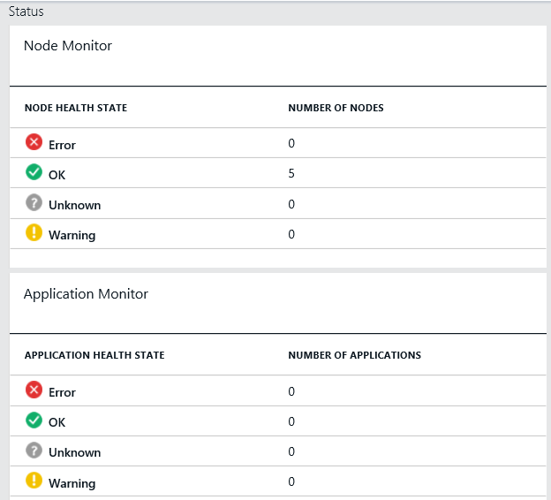
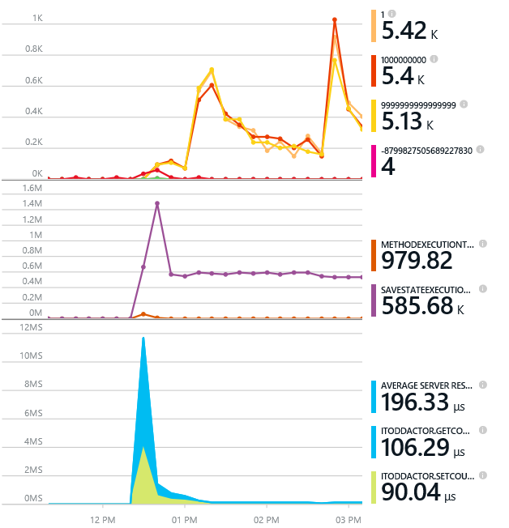
Monitoring your Services
Visibility into how your services are doing when running in production
Health status monitoring
Built-in health status for cluster and services
Flexible and extensible health store for custom app health reporting
Allows continuous monitoring for real-time alerting on problems in production
Performance and stress response
Rich built-in metrics for Actors and Services programming models
Easy to add custom application performance metrics

Slide 47
Diagnostics and Troubleshooting
Detailed System Optics
Repair suggestions. Examples: Slow RunAsync cancellations, RunAsync failures
All important events logged. Examples: App creation, deploy and upgrade records. All Actor method calls.
Custom Application Tracing
ETW == Fast Industry Standard Logging Technology
Works across environments. Same tracing code runs on devbox and also on production clusters on Azure.
Easy to add and system appends all the needed metadata such as node, app, service, and partition.
Choice of Tools
Visual Studio Diagnostics Events Viewer
Windows Event Viewer
Windows Azure Diagnostics + Operational Insights
Easy to plug in your preferred tools: Kibana, Elasticsearch and more

Slide 48
Scalability High Availability Reliability Resiliency Durability

Slide 49
Machine failure detection
Time = t₀
83
46
76
50
64
Nodes failed
Time = t₁
83
46
76
50
64
61
New Node arrived
Time = t₂
cluster reconfigured
83
46
Failures Detected
50
61

Slide 50
Stateful Microservices - Replication
Primary
Secondary
Replication
Service Fabric Cluster VMs

Slide 51
Replication
Reads are completed at the primary
Writes are replicated to the write quorum of secondaries
Ack
Read
Value
Write
Ack
P
Ack
Ack
Ack
S
S
Write
Write
S
S
Write
Write

Slide 52
Handling Machine Failures
#FAIL
App1
App2
App Type Packages
Service Fabric Cluster VMs

Slide 53
Reconfiguration
Types of reconfiguration
Primary failover
Removing a failed secondary
Adding recovered replica
Building a new secondary
Replica States
None
Idle Secondary
Active Secondary
Primary
X
Failed
P
S
P
B
S
S
X
Failed
S
S
Must be safe in the presence of cascading failures

Slide 54
LAB FIVE Monitor and diagnose services locally http://bit.ly/sf-lab-5

Slide 55
Health

Slide 56
Health Entities, Events, & States
Each entity has set of health events
Each event has a health state:
OK: No issues
Warning: An issue that may fix itself (ex: unexpected delay)
Error: Issue requiring action
Unknown: Entity not in health store
When evaluating an entity
SF aggregates entity’s & descendants’ events against policy
Deployed Apps → Warning
Applications → Error
Cluster
Nodes
Applications
Deployed Applications
Services
Deployed Service Packages
Partitions
Instances/ Replicas

Slide 57
Health Policies
Default: entity is healthy if it & children are healthy
In a world with regular failures, 20% Error might be considered Warning
Health policies define what healthy means
Cluster policy can be in cluster manifest
App policy can be in application manifest
Or, you can pass custom policy when querying health
<FabricSettings>
<Section Name="HealthManager/ClusterHealthPolicy">
<Parameter Name="MaxPercentUnhealthyApplications" Value="0"/>
<Parameter Name="MaxPercentUnhealthyNodes" Value="20"/>
</Section>
</FabricSettings>
<Policies>
<HealthPolicy MaxPercentUnhealthyDeployedApplications="20">
<DefaultServiceTypeHealthPolicy
MaxPercentUnhealthyServices="0"
MaxPercentUnhealthyPartitionsPerService="10"
MaxPercentUnhealthyReplicasPerPartition="0"/>
<ServiceTypeHealthPolicy ServiceTypeName="FrontEndSvcType"
MaxPercentUnhealthyServices="0"
MaxPercentUnhealthyPartitionsPerService="20"
MaxPercentUnhealthyReplicasPerPartition="0"/>
</HealthPolicy>
</Policies>

Slide 58
Health Policies & Timeouts
Health Policies
MaxPercentUnhealthyServices, MaxPercentUnhelathyDeployedApplications, ConsiderWarningsasError
UpgradeTimeout
If an entire upgrade hits this timeout, the upgrade is failed.
Upgrade DomainTimeout
If upgrading a UD hits this timeout, the upgrade is failed.
HealthCheckWaitDuration
After an UD is upgraded, wait for this time before checking health of nodes in that UD.
HealthCheckStableDuration
Even if the last health check passed, keep checking the health for this duration to ensure the upgrade is stable. If stable, upgrade the next UD.
UpgradeHealthCheckInterval
Keep checking health periodically with this interval until HealthCheckStableDuration is hit.
HealthCheckRetryTimeout
Once this time out is hit, stop checking health and fail the upgrade.

Slide 59
Health Failure Examples
Cluster: Nodes not responding to periodic heartbeat
Applications: Partition could not be placed
Service: Failed to place replica(s)
Partition: Below target instance count
Replica: Replica taking too long to open/close
Node: Node down, certificate expiration, load capacity violation
Deployed Applications: Failed to download code package
Deployed Service Packages: Service Package Activation, Code Package Activation, Service type registration, Download, Upgrade validation

Slide 60
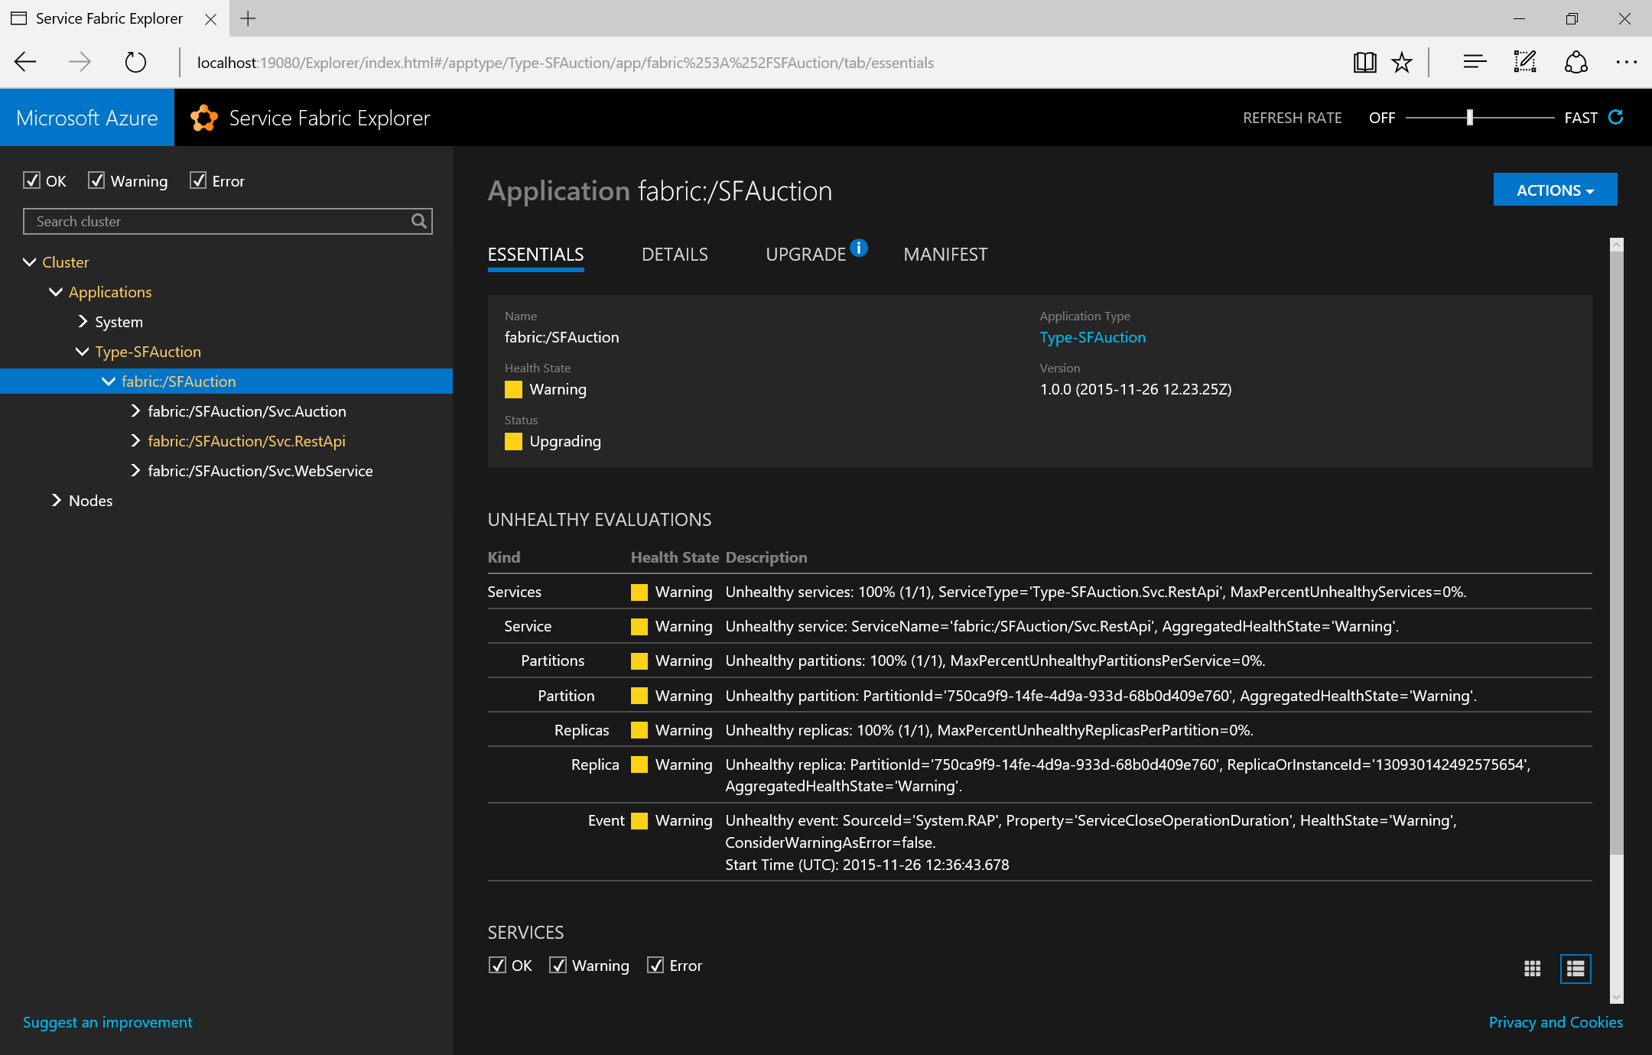

Slide 61
Example Health Failures
Cluster health failures
Nodes not responding to periodic heartbeat
Report: SourceId=System.Federation, Property=Neighborhood
Action: Check communication within cluster
Node health failures
Node Down
Report: SourceId=System.FM (failover manager), Property=State
Action: Wait for upgrade to complete; if taking too long, investigate
Certificate Expiration
Report: SourceId=System.FabricNode, Property=Certificate XXX
Action: Update certificate
Load Capacity Violation
Report: SourceId=System.PLB (placement load balancer), Property=Capacity
Action: View current node capacity & update metrics
Application health failures (System.CM=Cluster Manager)
Service failures (System.FM=Failover Manager)
Unplaced replicas violation
Report: SourceId=System.FM, Property=State
Action: Check service constraints

Slide 62
Example Health Failures
Partition failures (System.FM)
Replicas below minimum
Report: SourceId=System.FM, Property=State
Action: Check bug in service code’s Open/ChangeRole
Replica failures (System.RA [Reconfiguration agent])
Replica takes too long to open
Report: SourceId=System.RA, Property=RepliaOpenStatus
Action: Check service’s Open code
Slow service API call
Report: SourceId=System.RAP or System.Replicator, Property=[Name of slow API]
Action: Check service’s API code (possible unhandled exception)
Replica queue full warning
Report: SourceId=System.Replicator, Property=[Primary | Secondary]ReplicationQueueStatus

Slide 63
Example Health Failures
DeployedApplication (System.Hosting)
Activation
Report: SourceId=System.Hosting, Property=Activation (includes rollout version)
Download
Report: SourceId=System.Hosting, Property=Download
DeployedServicePackage (System.Hosting)
Service Package Activation
Report: SourceId=System.Hosting, Property=Activation
Code Package Activation
Report: SourceId=System.Hosting, Property=CodePackageActivation
Service type registration
Report: SourceId=System.Hosting, Property=ServiceTypeRegistration
Download
Report: SourceId=System.Hosting, Property=Download
Upgrade validation
Report: SourceId=System.Hosting, Property=FabricUpgradeValidation

Slide 64
Submitting Health Reports
Have “watchdog” periodically check service instance
Watchdog code/process can be in or out of the cluster
Keep watchdog simple and “bug-free”
Submit health reports via PowerShell, REST, .NET API
.NET API batches reports and sends ~30 seconds (default)
Submit helpful health reports that…
Prevent downtime, reduce issue investigation time, improve customer satisfaction
Ex: Diminishing disk space, bad perf, big queue size
Agents can poll health and take action (Ex: delete old files, send e-mails)
Note: Reports are deleted when entity deleted
To outlive entity, submit report on parent entity

Slide 65
Submitting a Health Report

Slide 66
What’s in a Health Report
For each entity, SF stores 1 health report per SourceId/Property
Mandatory Data | Description
Entity | Cluster, Node, App, Service, Partition, Replica, Deployed App, Deployed Service Pkg
SourceId | String uniquely identifies reporter
Property | Category (ex: “Storage” or “Connectivity”)
HealthState | Ok, Warning, Error
Optional Data | Default | Description
Description | “” | Human readable info
TimeToLive | Infinite | # seconds before report is expired
RemoveWhenExpired | False | Useful if TTL != Infinite. If false, report’s entity is in Error; else report removed after expiration.
SequenceNumber | Auto- generated | Increasing integer. Use to replace old reports when reporting state transitions.

Slide 67
What’s in a Health Event
SF wraps a health event around a health report
Property | Description
HealthInformation | The original health report
SourceUtcTimetamp | The time the health report was originally submitted
LastModifiedUtcTimestamp | The last time the report was modified
IsExpired | True if TTL expired and RemoveWhenExpired=false
LastOkTransitionAt LastWarningTransitionAt LastErrorTransitionAt | These give a history of the event’s health states. Ex: Alert if !Ok > 5 minutes

Slide 68
Health Report Submission Guidance
Never submit report not related to health
Health is not a generic reporting mechanism
Avoid reporting on state transitions because you’ll have to synchronize state across failures
Avoid SequenceNumber; accept auto-generated
Always clean up reports when no longer valid
Ex: Errors affect upgrades
So, have watchdog report periodically with TTL & RemoveWhenExpired=false
If watchdog fails, event’s IsExpired=true & entity’s health is Error
To have report self-expire, send with TTL & RemoveWhenExpired=true

Slide 69
LAB SIX Report and check health of services http://bit.ly/sf-lab-6

Slide 70
Setting-up a Cluster in Azure
Real Customers Real Workloads

Slide 71


Slide 72
300 +

Slide 73




















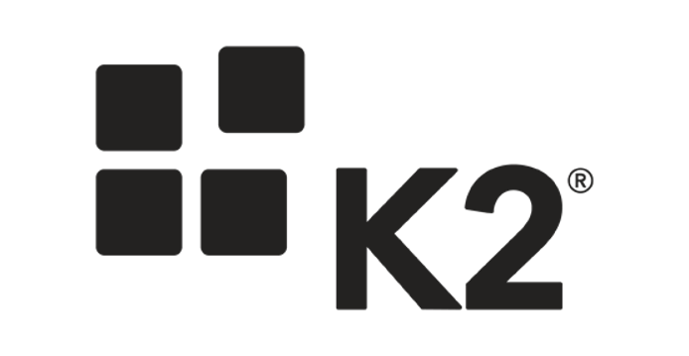
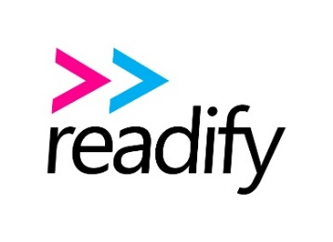

































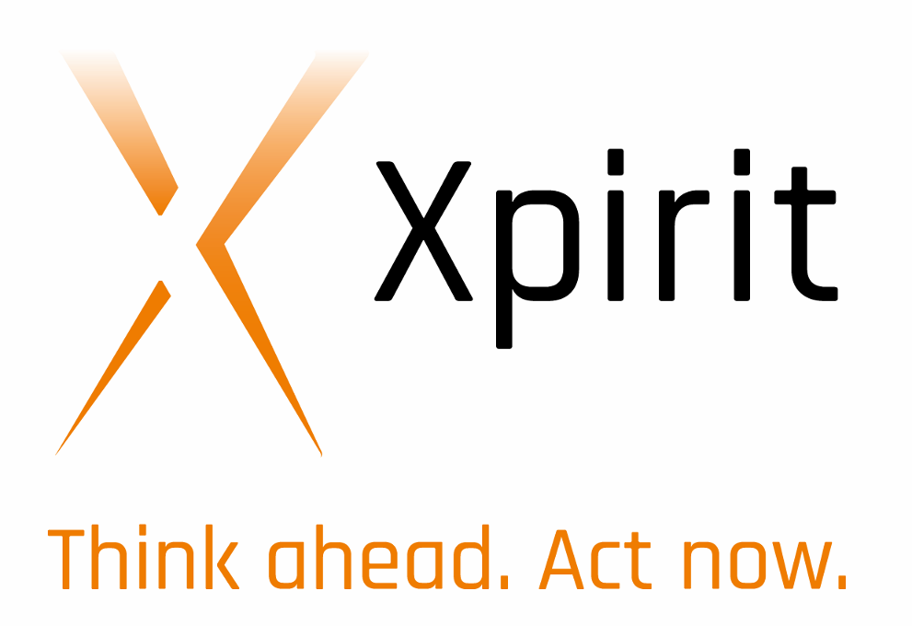







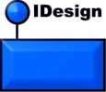










Slide 74


Age of Ascent & Service Fabric
Independent games studio specializing in massively multiplayer games
http://web.ageofascent.com/category/development/service-fabric/

Slide 75
Testability

Slide 76
Testability in Service Fabric
Two main test scenarios provided out of the box
Chaos tests
Failover tests
Tools
C# APIs (System.Fabric.Testability.dll)
PowerShell commandlets (runtime required)

Slide 77
What do we get from this Testability
Generates faults across the entire Service Fabric cluster
Compresses faults generally seen in months or years to a few hours
Combination of interleaved faults with the high fault rate finds corner cases that are otherwise missed
Leads to a significant improvement in the code quality of the service

Slide 78
Testability Actions
Actions | Description | Managed API | Powershell Cmdlet | Graceful/ UnGraceful Faults
CleanTestState | Removes all the test state from the cluster in case of a bad shutdown of the test driver. | CleanTestStateAsync | Remove-ServiceFabricTestState | Not Applicable
InvokeDataLoss | Induces data loss into a service partition. | InvokeDataLossAsync | Invoke-ServiceFabricPartitionDataLoss | Graceful
InvokeQuorumLoss | Puts a given stateful service partition in to quorum loss. | InvokeQuorumLossAsync | Invoke-ServiceFabricQuorumLoss | Graceful
Move Primary | Moves the specified primary replica of stateful service to the specified cluster node. | MovePrimaryAsync | Move-ServiceFabricPrimaryReplica | Graceful
Move Secondary | Moves the current secondary replica of a stateful service to a different cluster node. | MoveSecondaryAsync | Move-ServiceFabricSecondaryReplica | Graceful
RemoveReplica | Simulates a replica failure by removing a replica from a cluster. This will close the replica and will transition it to role 'None', removing all of its state from the cluster. | RemoveReplicaAsync | Remove-ServiceFabricReplica | Graceful
RestartDeployedCodePackage | Simulates a code package process failure by restarting a code package deployed on a node in a cluster. This aborts the code package process which will restart all the user service replicas hosted in that process. | RestartDeployedCodePackageAsync | Restart-ServiceFabricDeployedCodePackage | Ungraceful
RestartNode | Simulates a Service Fabric cluster node failure by restarting a node. | RestartNodeAsync | Restart-ServiceFabricNode | Ungraceful
RestartPartition | Simulates a data center blackout or cluster blackout scenario by restarting some or all replicas of a partition. | RestartPartitionAsync | Restart-ServiceFabricPartition | Graceful
RestartReplica | Simulates a replica failure by restarting a persisted replica in a cluster, closing the replica and then reopening it. | RestartReplicaAsync | Restart-ServiceFabricReplica | Graceful
StartNode | Starts a node in a cluster which is already stopped. | StartNodeAsync | Start-ServiceFabricNode | Not Applicable
StopNode | Simulates a node failure by stopping a node in a cluster. The node will stay down until StartNode is called. | StopNodeAsync | Stop-ServiceFabricNode | Ungraceful
ValidateApplication | Validates the availability and health of all Service Fabric services within an application, usually after inducing some fault into the system. | ValidateApplicationAsync | Test-ServiceFabricApplication | Not Applicable
ValidateService | Validates the availability and health of a Service Fabric service, usually after inducing some fault into the system. | ValidateServiceAsync | Test-ServiceFabricService | Not Applicable

Slide 79
Testability
Stateless:
Stop node (ungraceful)
Start node (N/A)
Restart node (ungraceful)
Validate application (N/A)
Validate service (N/A)
RestartDeployedCodePackage (ungraceful)
Restart partition (graceful)
Restart replica (graceful)
CleanTestState (N/A)
Failover/chaos tests
Stateful:
Move primary replica (graceful)
Move secondary replica (graceful)
Remove Replica (graceful)
InvokeQuorumLoss (graceful)
InvokeDataLoss (graceful)

Slide 80
LAB SEVEN Build and deploy any type of app http://bit.ly/sf-lab-7
https://github.com/Azure-Samples/service-fabric-dotnet-getting-started/tree/master/GuestExe/SimpleApplication
LAB EIGHT Simulate faults with testability
actions and scenarios http://bit.ly/sf-lab-8

Slide 81
Upgrading a Named Application

Slide 82
Updating Your App’s Service’s Code
Put new code in code package
Update ver strings (#s are not required)
Copy new app package to image store
Register new app type/ version
Select named app(s) to upgrade to new version
<ApplicationManifest ApplicationTypeName="DemoAppType" ApplicationTypeVersion="3.0" ...>
<ServiceManifestImport>
<ServiceManifestRef ServiceManifestName="WebServer" ServiceManifestVersion="2.0" .../>
</ServiceManifestImport>
</ApplicationManifest>
C
B2
B1
<ServiceManifest Name="WebServer" Version="2.0">
<ServiceTypes>
<StatelessServiceType ServiceTypeName="WebServer" ...>
<Extensions> ... </Extensions>
</StatelessServiceType>
</ServiceTypes>
<CodePackage Name="CodePkg" Version="1.1">
<EntryPoint> ... </EntryPoint>
</CodePackage>
<Resources><Endpoints> ... </Endpoints></Resources>
</ServiceManifest>
A

Slide 83
Upgrade Domains
Prevent complete service outage while upgrading
More UDs → less loss of scale but more time to upgrade
# UD set when cluster created via cluster manifest; ARM template
Default=5; 20% down at a time
IMPORTANT: 2 versions of your code run side-by-side simultaneously
Beware of data/schema/protocol changes; use 2-phase upgrade
Below shows 9 nodes spread across 5 UDs
UD #1
UD #2
UD #3
UD #4
Node #5
Node-1
Node-2
Node-3
Node-4
Node-5
Node-6
Node-7
Node-8
Node-9

Slide 84
Fault Domains
fd:/DC1/R1/B1
fd:/DC1/R1/B2
fd:/DC1/R1/B3
fd:/DC1/R2/B1
fd:/DC1/R2/B2
fd:/DC1/R2/B3
fd:/DC2/R1/B1
fd:/DC2/R1/B2
fd:/DC2/R1/B3
fd:/DC2/R2/B1
fd:/DC2/R2/B2
fd:/DC2/R2/B3
…
Isolate cluster from a single point of hardware failure (fault)
Determined by hardware topology (datacenter, rack, blade)
DC1
DC2
DC3
R1
R2
R1
R2
R1
R2
B1
B1
B1
B1
B1
B1
B2
B2
B2
B2
B2
B2
B3
B3
B3
B3
B3
B3

Slide 85
Start-ServiceFabricApplicationUpgrade
Parameter | Default | Description
ApplicationName | N/A | Application Instance name
TargetApplicationTypeVersion | N/A | The version string you want to upgrade to
FailureAction | N/A | Rollback (to last version) or Manual (stop upgrade & switch to manual)
UpgradeDomainTimeoutSec | Infinite | If any UD takes more than this time, FailureAction
UpgradeTimeout | Infinite | If all UDs take more than this time, FailureAction
HealthCheckWaitDurationSec | 0 | After UD, SF waits this long before initiating health check
UpgradeHealthCheckInterval | 60 | If health check fails, SF waits this long before checking again (set in cluster manifest; not PowerShell)
HealthCheckRetryTimeoutSec | 600 | Maximum time SF waits for app to be healthy
HealthCheckStableDurationSec | 0 | How long app must be healthy before upgrading next UD

Slide 86
Optional Health Criteria Policies
Parameter | Default | Description
ConsiderWarningAsError | False | Warning health events are considered errors stopping the upgrade
MaxPercentUnhealthyDeployedApplications | 0 | TODO: Max unhealthy before app is declared unhealthy
MaxPercentUnhealthyServices | 0 | Max service instances unhealthy before app is declared unhealthy
MaxPercentUnhealthyPartitionsPerService | 0 | Max partitions unhealthy before service instance is declared unhealthy
MaxPercentUnhealthyReplicasPerPartition | 0 | Max partition replicas unhealthy before partition is declared unhealthy
UpgradeReplicaSetCheckTimeout | Infinite 900 (rollback) | Stateless: How long SF waits for target instances before next UD Stateful: How long SF waits for quorum before next UD
ForceRestart | False | Forces service restart when updating config/data

Slide 87
Managing Named Application Upgrades
Get progress via Get-ServiceFabricApplicationUpgrade
Most problems are timing related
Instances/replicas not going down quickly
UDs not coming up in time
Failing health checks
If FailureAction is “Manual”, you can:
Optional: After all named apps upgrade, unregister old app type
Action | PowerShell Command
Rollback | Start-ServiceFabricApplicationRollback
Start next UD | Resume-ServiceFabricApplicationUpgrade
Resume monitored upgrade | Update-ServiceFabricApplicationUpgrade

Slide 88
Application Upgrade
Upgrade Domain #1
Upgrade Domain #2
Upgrade Domain #3
App Repository
Windows OS
Windows OS
App A v1
Windows OS
App C v2
App A v1
App C v1
Fabric
Node
App B v2
Fabric
Node
Fabric
Node
App B v2
App C v2
App C v1
App C v1
App C v2
Windows OS
Windows OS
Windows OS
Fabric
Node
App B v2
App C v2
App B v2
App C v1
Fabric
Node
App A v1
App A v1
Fabric
Node

Slide 89
LAB NINE Perform an app upgrade http://bit.ly/sf-lab-9
Clone repository in VS
https://github.com/Azure-Samples/service-fabric-dotnet-getting-started.git
StatefulVisualObjectActor.cs is now VisualObjectActor.cs

Slide 90
Updates Since //Build 2015
Now Globaly Available
Create Clusters via ARM & Portal
Hosted Clusters in Azure
Many Performance, Density, & Scale Improvements
Many API Improvements
New Previews
Linux Support
Java Support
Docker & Windows Containers
On Premises Clusters

Slide 91
Call to Action
Download the Service Fabric developer SDK
http://aka.ms/ServiceFabricSDK
Download the standalone Service Fabric preview for Windows Server
http://aka.ms/ServiceFabricWS2012R2
Learn from samples and complete solutions
http://aka.ms/ServiceFabricSamples
Signup for Service Fabric on Linux
http://aka.ms/SFlinuxpreview
Provide feedback
http://aka.ms/ServiceFabricForum
Twitter HashTag #AzureServiceFabric
Learn from the tutorials and videos
http://aka.ms/ServiceFabricDocs

Slide 92
Stephane Lapointe, Orckestra - stephane@stephanelapointe.net / @s_lapointe
Guy Barrette, freelance Architect/Developer - guy@guybarrette.com / @GuyBarrette
Francois Boucher, Lixar IT - fboucher@frankysnotes.com / @fboucheros
Alexandre Brisebois, Microsoft – alexandre.brisebois@microsoft.com / @brisebois

